Slide 1
Operating System Security
Asst Prof. Tianwei Zhang
12 November 2020

Slide 2
Self-Introduction
Experience
2019–present: Assistant Professor @ SCSE, NTU
2017–2019: Software Engineer @ Amazon Web Services
Cloud Computing and Robotics platforms
2011–2017: PhD @ EE, Princeton University
Thesis topic: cloud computing security
Research interest
Design and develop secure computer systems
Principle: enhance system security without compromising performance, cost and usability.

Slide 3
Questions Before Our Course
If you download and run a video player app on your computer, can it delete your photos?
If you install a maps app on your smartphone, can it steal your privacy information?
If you click the attachment of an unknown email, can it destroy your data on the disk?
Yes, if your OS does not have appropriate security protection, e.g., app isolation, permission management

Slide 4
Outline
System security basis
Definition
Security properties
Security Protection Stages employed by OS
Authentication
Access Control
Audit
Security Threats in OS
Hardware Protection
Integrity verification
Trusted Execution Environment

Slide 5
Outline
System security basis
Definition
Security properties
Security Protection Stages employed by OS
Authentication
Access Control
Audit
Security Threats in OS
Hardware Protection
Integrity verification
Trusted Execution Environment

Slide 6
OS Becomes more Complex
From single-user to multi-user
DOS is truly single user
MacOS, Linux, NT-based Windows are multi-user, but typically only 1 user in PCs.
Cloud computing allows multiple users all over the world to run on the same OS, and they do not know each other.
Tradeoff: efficiency versus security
From trusted apps to untrusted apps
Simple real-time systems: only run one specific app
Runs verified apps from trusted parties
Modern PCs and smartphones: run apps from third-party developers
Tradeoff: functionality versus security

Slide 7
Complex OS brings More Challenges
Protecting a single computer with one user is easy
Prevent everybody else from having access
Encrypt all data with a key only one person knows
Sharing resources safely is hard
Preventing some people from reading private data (e.g. grades)
Prevent some people from using too many resources (e.g. disk space, CPU core)
Prevent some people from interfering with other programs (e.g. inserting keystrokes / modifying displays)

Slide 8
OS Responsibility
Functionalities
Support multiple users concurrently
Manage multiple apps concurrently
Connect to the network
Sharing data with different domains
Security goals
Protect users from each other
Protect apps from each other
Protect the system from the network
Secure the data sharing

Slide 9
What’s being protected? Resources
System is secure if resources used and accessed as intended under all circumstances
User
Processes
Resource
OS
Processes
User
Resource
Processes
User
Resource
Processes

Slide 10
Security Properties
Confidentiality (C)
Prevent unauthorized disclosure of information
Sensitive information should not be leaked to unauthorized parties
Integrity (I)
Prevent unauthorized modification of information
Critical system state and code cannot be altered by malicious parties
Availability (A)
Prevent unauthorized withholding of information or resources
The resources should be always available for authorized users
Other properties
Accountability: actions of an entity can be traced and identified
Non-repudiation: unforgeable evidence that specific actions occur

Slide 11
Outline
System security basis
Definition
Security properties
Security Protection Stages employed by OS
Authentication
Access Control
Audit
Security Threats in OS
Hardware Protection
Integrity verification
Trusted Execution Environment

Slide 12
Security Protection from OS
OS is responsible for protecting the apps running on it
OS controls what users/processes can do
Authorization
Accountability
Identification & authentication
Access control
Logging & auditing
Preventive
Reactive

Slide 13
Authentication
How does a computer know if I am a correct user?
What you know? password, PIN, public/private keys…
What you have? smartcard, hardware tokens…
Who you are? biometrics, face recognition, voice recognition…
How does the system conduct authentication?
Compare the input credential with the stored one
- Password file: /etc/passwd for UNIX
Allow entry when the credential matches
- Assign the user an identifier: 32bit for UNIX

Slide 14
Hash Function
A one-way function f
Takes an input 𝑥 of arbitrary length, and produces an output 𝑓(𝑥) of fixed length.
Pre-image resistant
Given an input 𝑥 it is easy to compute 𝑓(𝑥), but given an output 𝑦 it is hard to find 𝑥 so that 𝑦 = 𝑓(𝑥)
Collision resistant
It is computationally infeasible to find a pair (𝑦₁, 𝑦₂), such that 𝑦₁≠𝑦₂ and 𝑓(𝑦₁) = 𝑓(𝑦₂)

Slide 15
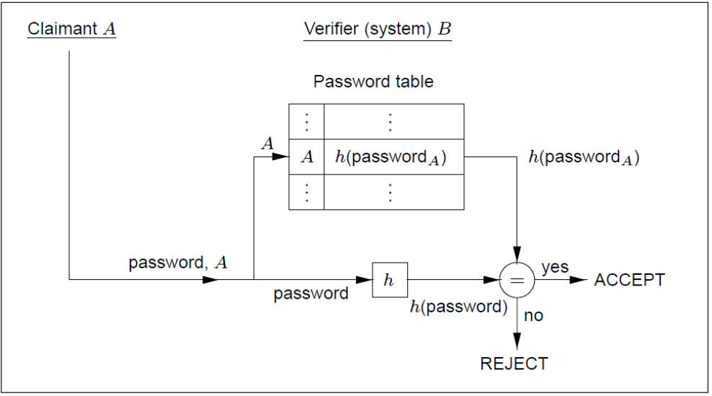
Password Storage
Hashed passwords
Passwords are hashed and stored in a password table
When a user inputs a password, its hash value is computed and checked against the password table.

Slide 16
Password Security
Why hashed passwords?
Insider attack: even the attacker can access the password table, he is not able to recover the password from the hash values.
Dictionary attack
Hashed passwords, especially for human-generated passwords, are still vulnerable to dictionary attack.
This exploits weakness in human-chosen passwords, which tend to derive from words in natural languages.
Guess some commonly used passwords
Compute their hash values
Look for the same hash values in the password table

Slide 17
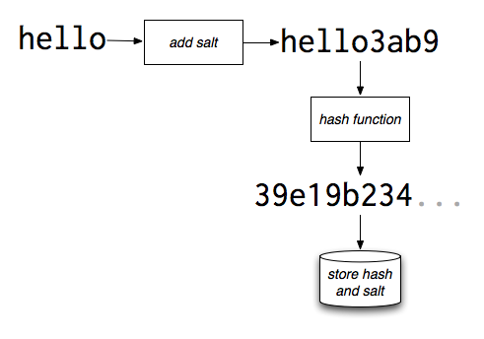
Preventing Dictionary Attack
Password salting
A salt is added to a password before applying the hash function
A salt is a random string
Each password has its own unique salt. So even the same password will have different hash values
The salt value is stored along with the hash of the password + salt
The attacker needs more hash computation to recover passwords

Slide 18
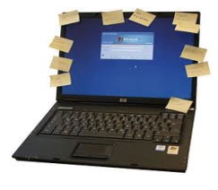
Password Complexity
Set up higher requirements for the password
Larger space (lower case, upper case, numbers, special symbols…)
Length
No consecutive repeated characters; Not in a dictionary
Pros:
Increase the difficulty of password guessing attack
Cons:
Hard to remember, and easy to type wrong
People may try to choose passwords that are easy to remember: attacker can guess them easily as well
People may reuse the old passwords
People write down the passwords.

Slide 19
Access Control
Security policy
Specifies (subject, verb, object) triples
Subject = (user, program) pair
Verb = action
Object = resources
Monitor
Checks whether the action should be allowed
Action
(User, program)
Monitor
Resource
Policy

Slide 20
Access Control Policy
Who sets policy?
Users, with some system restrictions
How is access control list stored?
Sparse matrix (default deny), store as list
How is policy enforced?
OS exposes API to apps, with privileged operations
Checks ACL when API functions are called

Slide 21
Authorization
Access Control Matrix
Each column represents an object
Each row represents a subject
The entry shows the allowed verbs.
 | /etc | /homes | /usr
Alice | Read | Read | Read Write
Bob | Read Write | Read Write | Read Write
Carl | None | None | Read

Slide 22
Update Access Matrix
Access Control Changes
Grant capabilities: the owner of the object can grant rights to other users.
Revoke capabilities: subjects can revoke the rights from others
Six Commands to Alter the Access Matrix
create subject 𝑠: creates a new subject s.
create object 𝑜: creates a new object o.
enter 𝑟 into 𝑀𝑠,𝑜: adds right 𝑟 to cell 𝑀𝑠,𝑜.
delete 𝑟 from 𝑀𝑠,𝑜: deletes right 𝑟 from cell 𝑀𝑠,𝑜.
destroy subject 𝑠: deletes subject s. The column and row for s in 𝑀 are also deleted.
destroy object 𝑜: deletes object 𝑜. The column for 𝑜 in 𝑀 is also deleted.

Slide 23
More Representations
Access Control List (ACLs)
For one object, which subject has accesses to it? (check the column in the Access Matrix)
Capability:
For one subject, which objects it has capability to access? (check rows in the Access Matrix)
Most systems use both
ACLs for opening an object (e.g. fopen())
Capabilities for performing operations (e.g. read())

Slide 24
Data Sharing
Problem: multiple users want to access the same file or data
Give each user the corresponding permissions.
When a new user joins, the permissions have to be granted again.
When permissions are changed, need to alter each user.
Solution: group
Set permissions for the group instead of the user
A user joining the group will have the corresponding permissions.
A user quitting the group will loss the corresponding permissions.
Easier to manage and update.

Slide 25
Audit Logs
Audit trail
Recording all protection-orientated activities, important to understanding what happened, why, and catching things that shouldn’t
/usr/adm/lastlog | Records the last time a user has logged in; displayed with finger
/var/adm/utmp | Records accounting information used by the who command.
/var/adm/wtmp | Records every time a user logs in or logs out; displayed with the last command.
/var/adm/acct | Records all executed commands; displayed with lastcomm
/var/log/ | In modern Linux systems, log files are located in there

Slide 26
Outline
System security basis
Definition
Security properties
Security Protection Stages employed by OS
Authentication
Access Control
Audit
Security Threats in OS
Hardware Protection
Integrity verification
Trusted Execution Environment

Slide 27
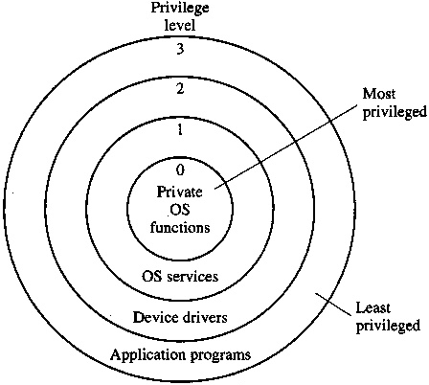
Privileged Rings
Operating modes
Kernel mode has the highest privileges, running the critical functions and services
Entities with the higher privilege levels cannot call the functions and access the objects in the lower privilege levels directly.
- System call, interrupt, etc.
Status flag allows system to work in different modes (context switching)

Slide 28
Malware
Software code that maliciously subvert the computer system
Virus: malicious program that causes copies of itself to be created when trigged by the user
Worms: malicious program that causes copies of itself to be created without any user intervention
Trojan horses: appears to do something useful, but masks some hidden malicious activities
Rootkit: hides other malware from detection and maintains root-level access to the computer.
Backdoor: allow a remote party to gain access to the computer
Bot: inserted into a computer and lies dormant until invoked by remotely to perform a function
Spyware: inserted into the computer to capture users’ data
Ransomware: locks up data via encryption, demanding payment to unlock it

Slide 29
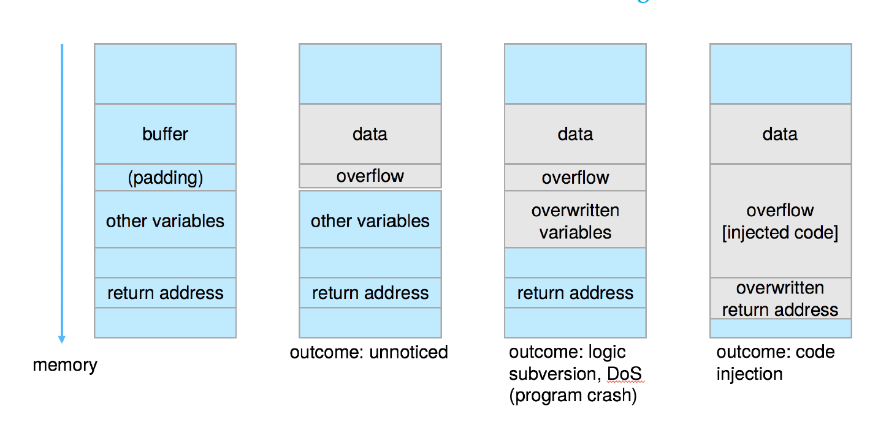
How to Inject Malware?
Code-injection attack
The system code is not malicious but has bugs allowing executable code to be added or modified
Buffer overflow
#include <stdio.h>
#define BUFFER SIZE 256
int main(int argc, char *argv[])
{
char buffer[BUFFER SIZE];
if (argc < 2)
return -1;
else {
strcpy(buffer,argv[1]);
return 0;
}
}

Slide 30
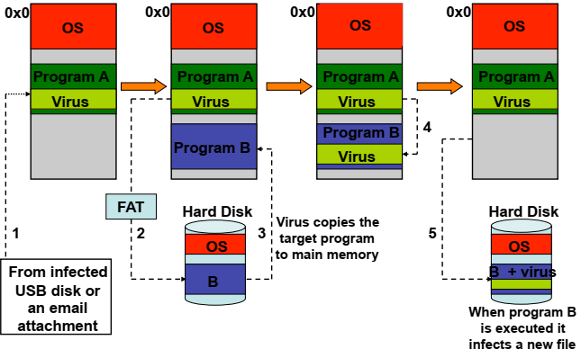
How to Propagate Malware?
Virus tries to copy itself to other programs and propagate it to other systems

Slide 31
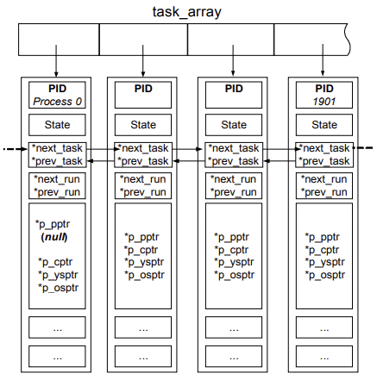
How to Hide Malware?
Rootkits hook the function called by the anti-malware, and remove their existences
Windows:
NtOpenProcess
NtQuerySystemInformation
PsActiveProcessLinkHead
Linux:
Proc filesystem (procfs)
task_struct

Slide 32
Outline
System security basis
Definition
Security properties
Security Protection Stages employed by OS
Authentication
Access Control
Audit
Security Threats in OS
Hardware Protection
Integrity verification
Trusted Execution Environment

Slide 33
Computer System: A Hierarchic View
System layers
Different scenarios may have different layers
Lower layers have higher privileges and can protect higher layers.
Lower layers need to be better protected
Apps
Container
OS
VM
Firmware
Hardware

Slide 34
Chains of Trust
Establish verified systems from bottom to top
The bottom layers validate the integrity of the top layers
If the verification passes, then it is safe to launch it.
Each layer is vulnerable to attack from below if the lower layers are not secured appropriately
Apps
Container
OS
VM
Firmware
Hardware

Slide 35
Integrity Verification
Only execute code signed by an entity we trust
Load the bootloader in the firmware
Reads and verifies the kernel
Only loads kernel if the signature is verified
Similarly, kernel can run only verified applications
Program Binary
Signature
Hash binary, verify signature
Public Key
Certificate Authority
Signature matches?
Continue Execution
Flag error, refuse exec

Slide 36
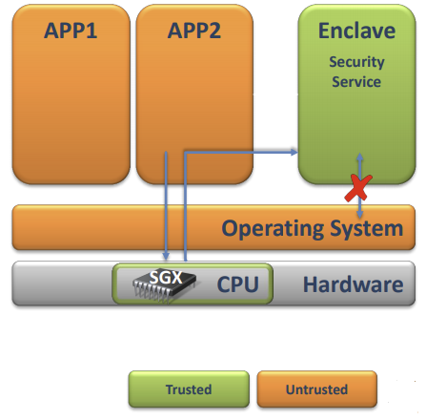
Protect Applications from Untrusted OS
Building a secure OS is difficult
Large code base size and complex functionalities
An untrusted OS can compromise all applications
Can we protect the security of apps even when the OS is malicious?
Solution: Intel Secure Guard Extension (SGX)
Security critical code isolated in enclave
Only CPU is trusted
Memory is encrypted
Support remote attestation

Slide 37
Thank You!
tianwei.zhang@ntu.edu.sg

